Slide 2
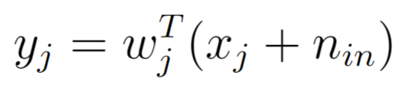
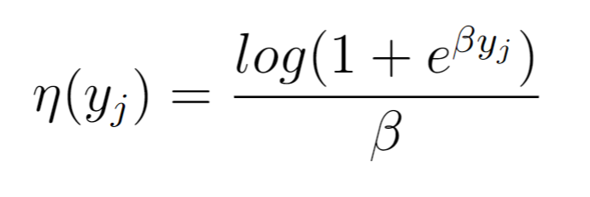
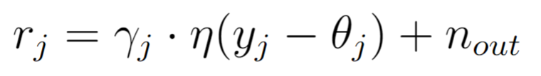
Forward model in 3 easy steps
1- Linear weighted inputs
2- Softplus output nonlinearity
3- Gain and threshold

Slide 3
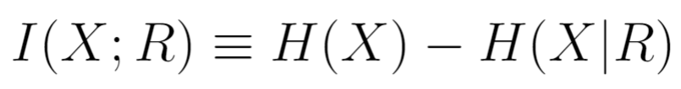
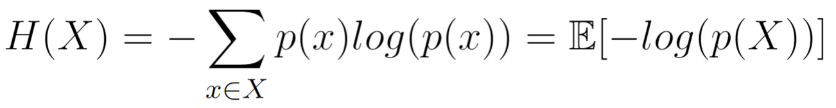
Maximizing mutual information

Slide 4
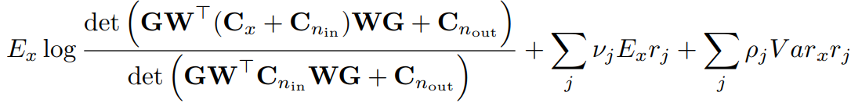
Firing rate constraint – Lagrange multipliers

Slide 5
Firing rate constraint – Gain adjustments
What if we adjust γ so that firing rate is constant?

Slide 6
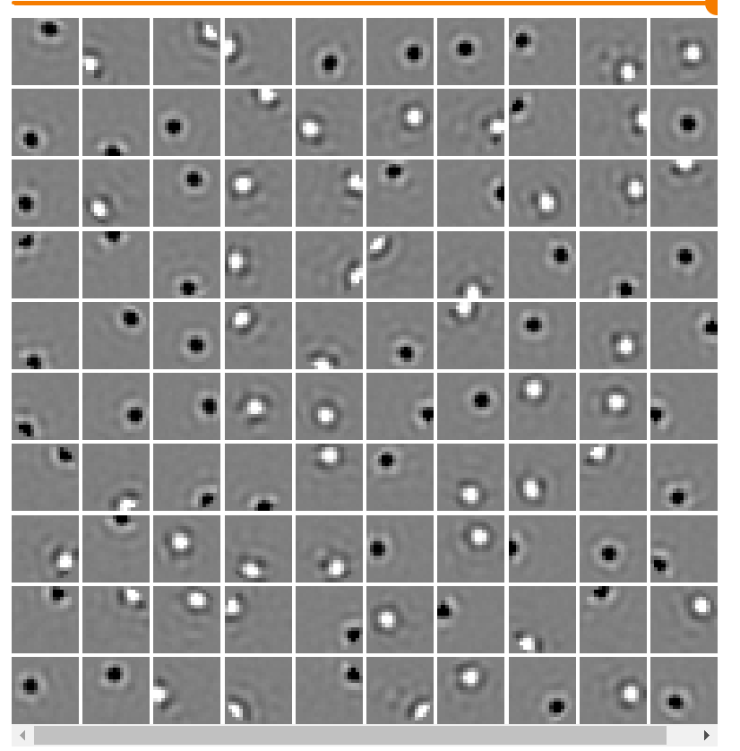
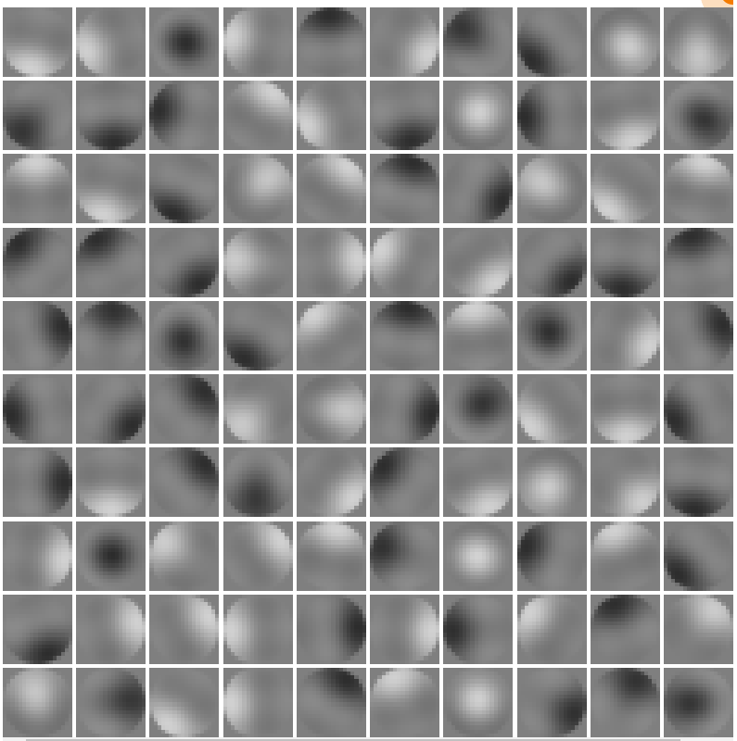
Receptive fields with Gamma method are more spread
Lagrange multipliers
Gamma method

Slide 7
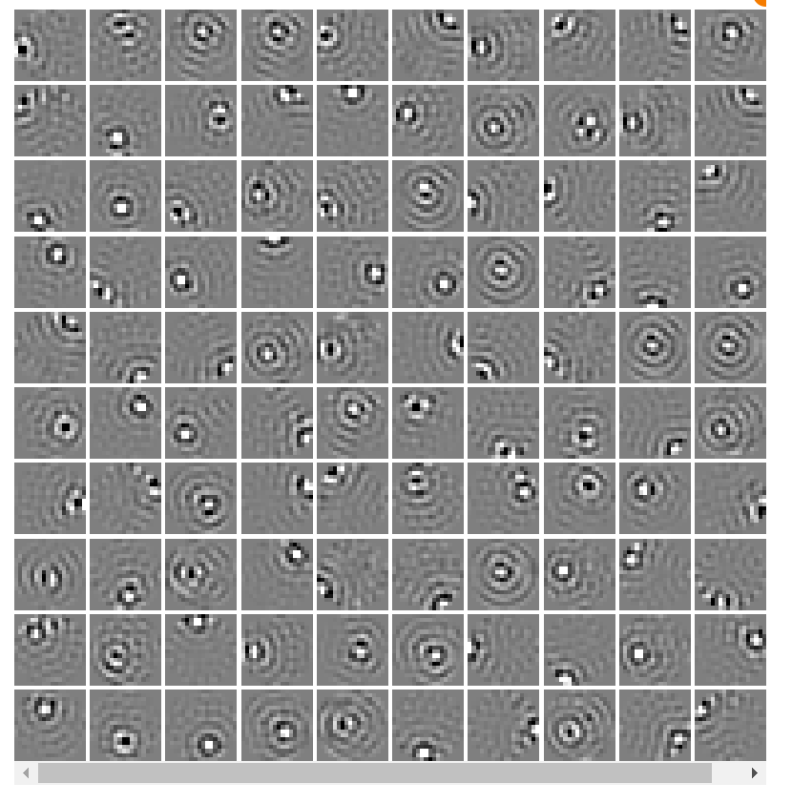
For reference: RFs with no constraint

Slide 8
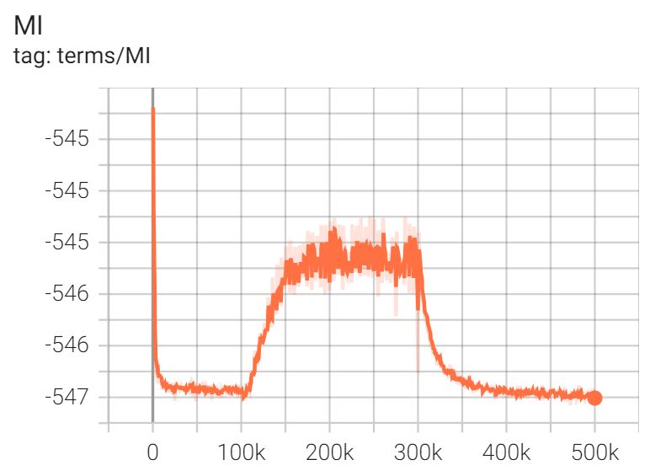
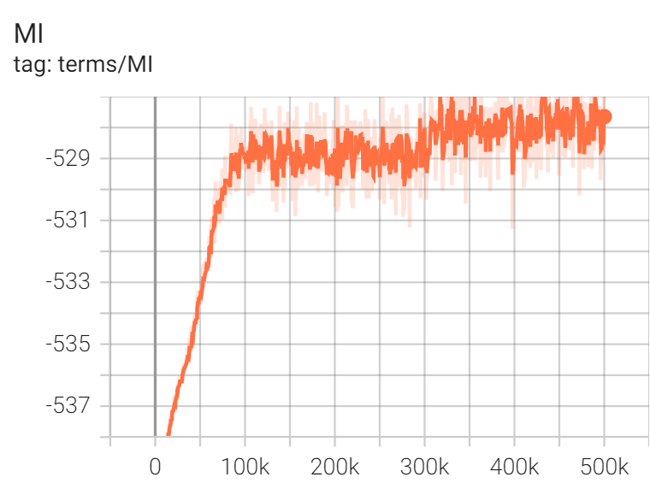
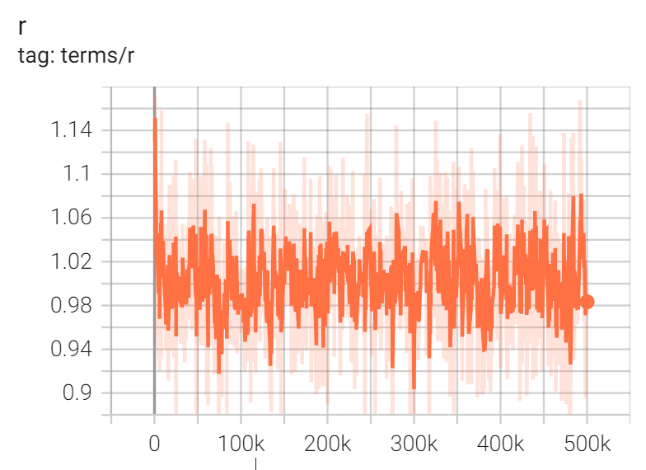
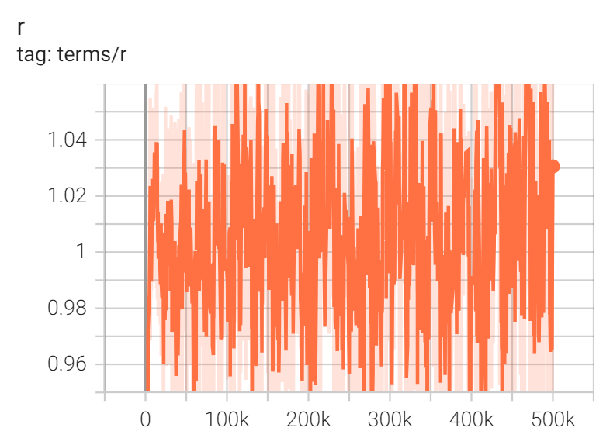
Firing rate constraint does work
Lagrange multipliers
Gamma method

